Slide 1


Watershed Tools for Local Leaders Seminar
Stream Buffer Restoration Project
Kristi MacDonald, Director of Science
Melissa Mitchell Thomas, GIS and IT Specialist
March 1, 2018

Slide 2


Our Mission
Protecting the water in our rivers, our streams, and our homes through science, education, advocacy, stewardship, and preservation.

Slide 3
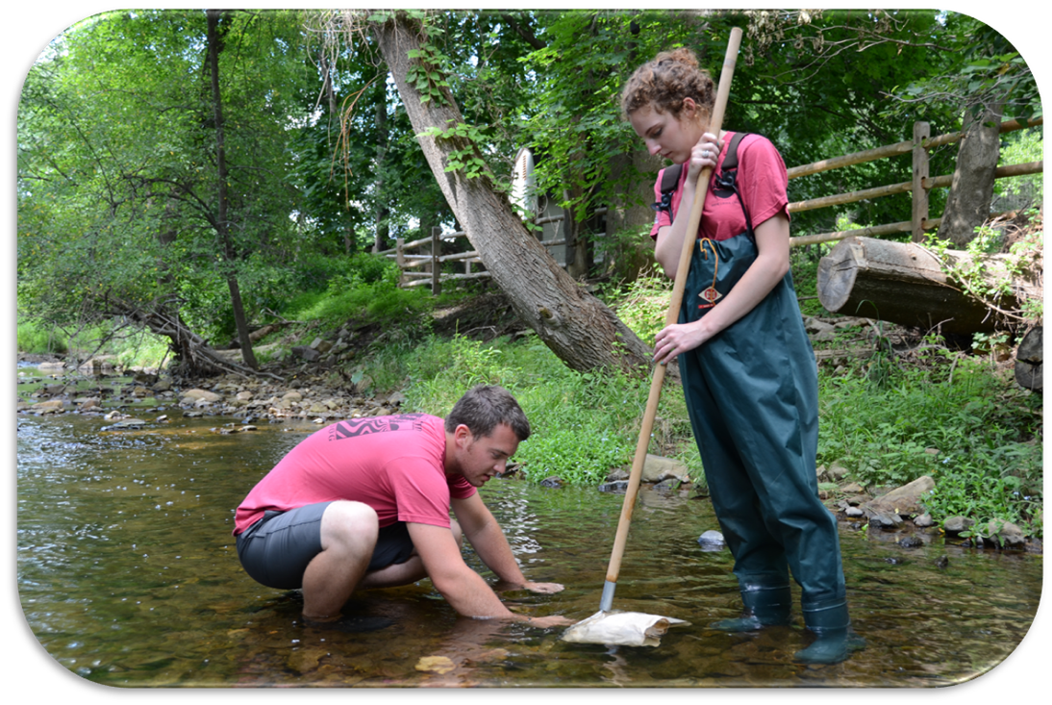
Volunteer Stream Monitoring Program
Notes:
-Do we have any stream monitors in the audience? The volunteers have a blue circle on their nametags
-This past June, 110 volunteers and staff monitored 67 stream monitoring sites.
-Pictured here are stream monitors using a net to collect a sample of the organisms that live in the stream

Slide 4
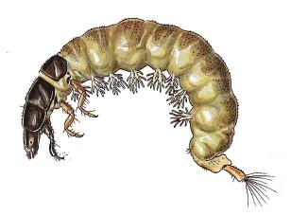
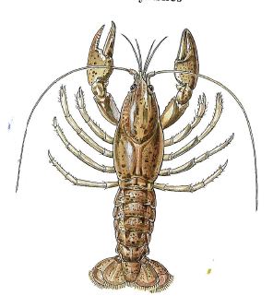
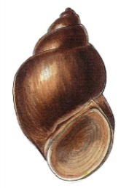
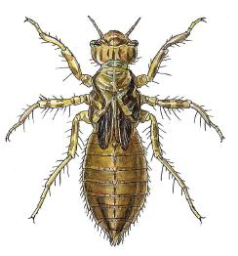
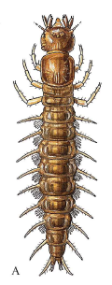
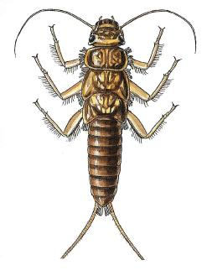
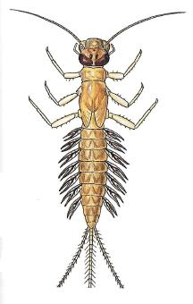
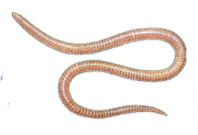
Benthic Macroinvertebrates
Notes:
-The biological sample consists of benthic macroinvertebrates
-Does any one want to take a stab at the definition of a benthic macroinvertebrate? I like to call them macros for short. Macros are organisms that live on the bottom of the stream that lack back bones and can be seen by your bare eye without the aid of a microscope
-In a healthy stream you would expect to find a diverse sample of organisms as pictured here. However, these macros have different tolerances to pollution
If a stream becomes stressed due to pollution, for example the water temperature increases and there is less dissolved oxygen available, the organisms that are the most sensitive to pollution will be unable to persist and will not be present in the sample
If the stress continues to intensify, then the organisms that are somewhat sensitive to pollution will also die
Only the macros that are tolerant to pollution will remain and the sample will be very limited in diversity
The samples are sent to a lab for analysis and they provide us with water quality ratings based on the High Gradient Macroinvertebrate Index
-The High Gradient Macroinvertebrate Index is based on the presence, abundance, and pollution tolerance of the benthic macroinvertebrate community that are collected in the stream sample.

Slide 5
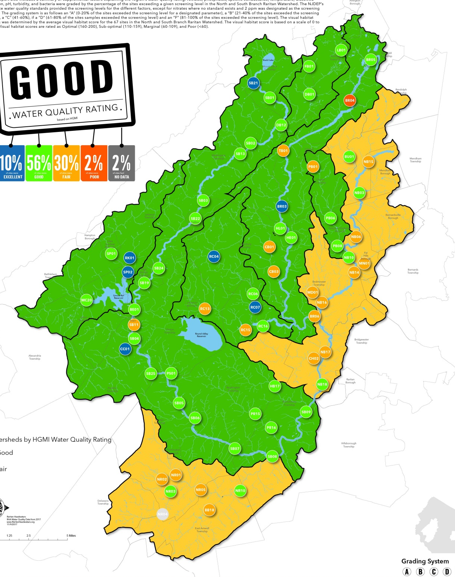
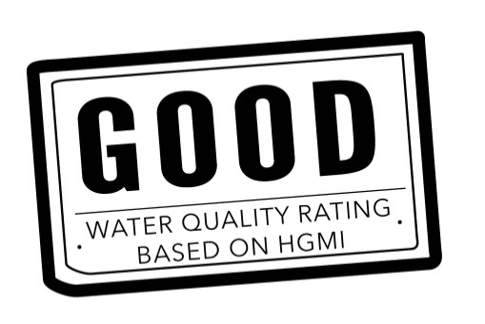
2017 Regional Water Quality
2017 Stream Monitoring Sites
Average Water Quality by Major Watershed
Notes:
-In 2017, the overall water quality for the Raritan Headwaters Region was good based upon the average High Gradient Macroinvertebrate Index scores at the 67 sites we monitored– still room for improvement
-The circles on the map illustrate the water quality ratings at our stream monitoring sites. In 2017, we added new sites in the western portion of our watershed and we have completed our stream monitoring program expansion.
-Blue circles represent a site with excellent water quality. All headwater streams should be excellent. One of our new sites on the Rocky Run in Lebanon Township had the highest water quality this year.
-Green circles represent good sites. Orange circles represent fair sites.
-Red circles are poor. Our only site with poor water quality this year was Black River Site 4 at the border of Randolph and Roxbury Township
-A grey circle means that we did not collect any data at that site in 2017.
-Our major watersheds are outlined in black. Their background color represents the average water quality of the sites that fall within them.
The watersheds that are colored green represent areas where we need to protect water quality and the watersheds that are orange represent areas where streams need restoration.
-It jumps out that there are issues in the Neshanic River and North Branch Raritan River.

Slide 6
Water Quality Summary
Changes between 2016-17 | % of Sites
Remained Acceptable | 46
Remained Unacceptable | 24
Improved | 15
Declined | 7
New | 6
No Data | 2
Notes:
-In 2017, 10% of our stream monitoring sites were excellent, nearly 60% were good, about 1/3 were fair and 2% were poor. There was only one site without data along the Neshanic because we were not given permission to monitor
-A site that that had good or excellent water quality for two years in a row is considered to remain acceptable for aquatic life use under the Federal Clean water act
-A site that that had fair or poor water quality for two years in a row is considered to remain unacceptable for aquatic life use under the Federal Clean water act
More sites improved in water quality than declined
One factor that may have contributed to this is a return to normal stream flows after a mild, rainy spring removed any lingering drought concerns.

Slide 7



Regional Summary of Indicators Measuring
Stream Health
Temperature
Dissolved Oxygen
pH
Turbidity
Habitat Score
Specific Conductance
Nitrates
Bacteria
Phosphate
Notes:
We also collected additional information on the water chemistry, bacterial levels and habitat in June. After grading each parameters, it became clear that the Raritan Headwaters region faces challenges with Nitrates, bacteria, and phosphate pollution.
Trees are a simple solution to reduce nitrates and phosphate. Therefore, Trees are our key partners in protecting water quality

Slide 8
We have the data, now let’s do something
Land Preservation
Acquisition
Easements
Regulations
Land use planning
Restoration & Stewardship
In stream restoration
Dam removal
Riparian forest or wetland restoration
Invasive control
Best Management Practices (BMPs)
River Friendly Program
  Residents
  Farms
  Schools
  Businesses
Local Ordinances
Regulations
Well testing and septic maintenance
Notes:
The main strategies we use to protect water resources can be divided into preserving the important forests and wetlands necessary for maintaining water resource quality and quanitity, fixing past mistakes through restoration and caring for the land through stewardship acitivities and the behaviors or Best Management Practices we all can modify to better protect our water especially from non-point source pollution and stormwater runoff.

Slide 9
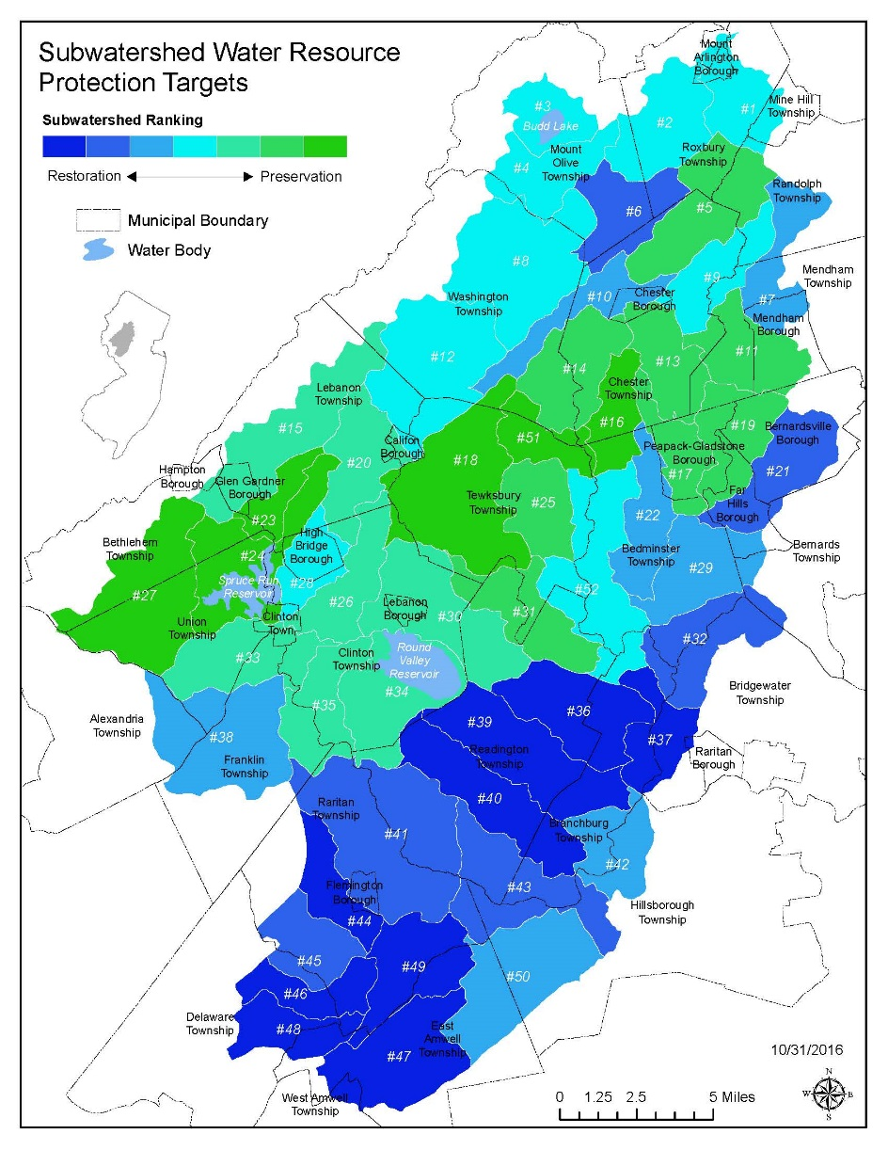
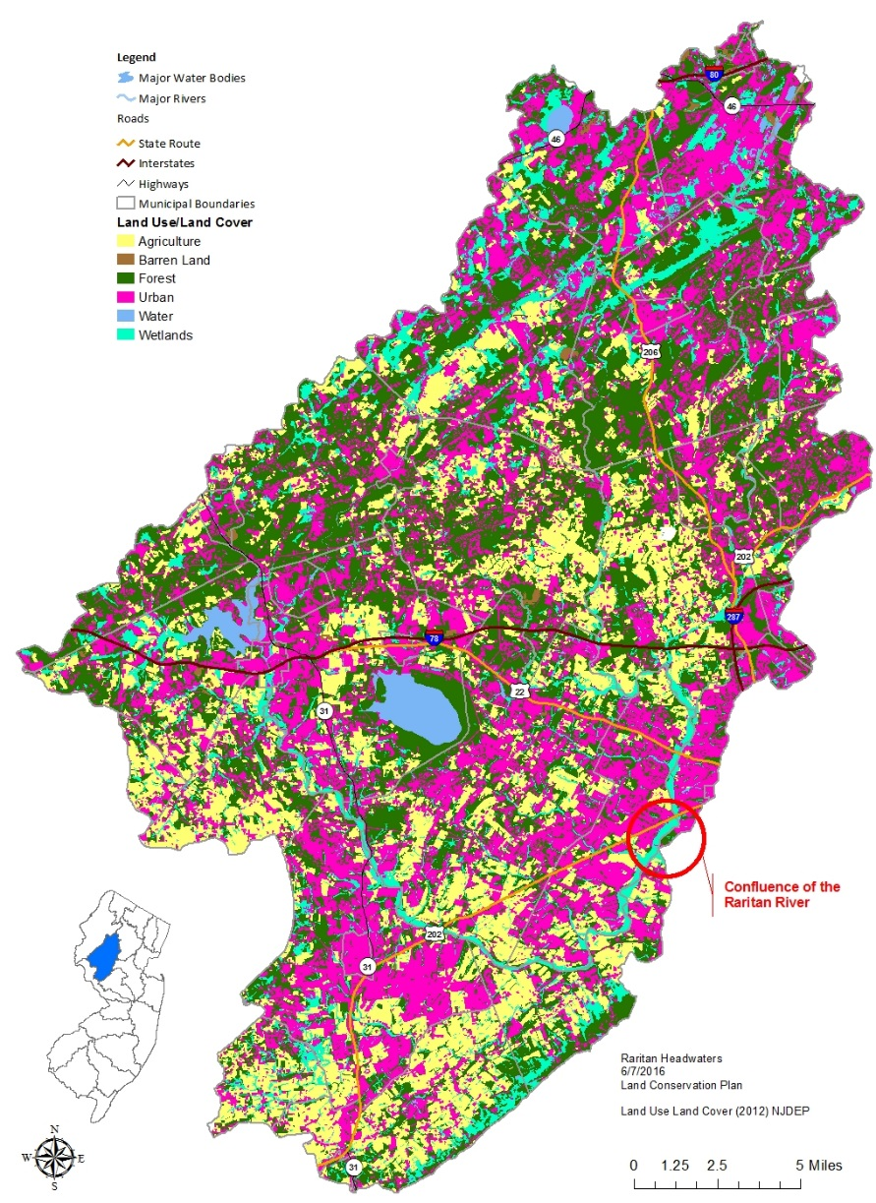
Notes:
Need to analyze the restoration end of the spectrum more carefully. There will be major differences between agricultural and urban land use in the types of restoration and BMPs that need to implement as well as differences in the way they impact water quality. Also, need to decide on weighting based on importance of each category because right now they are weighted equally. We will be considering open space preservation. Also, we will be undergoing further peer review and we welcome comments.

Slide 10
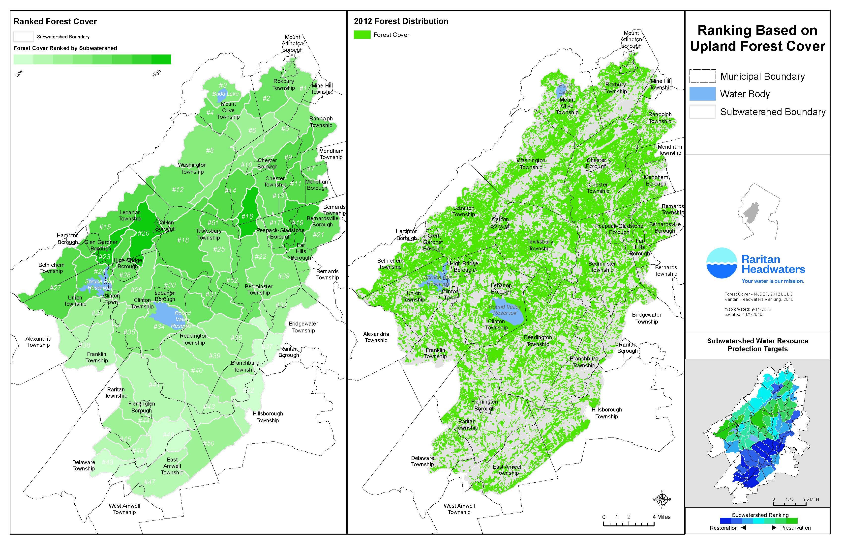

Slide 11
Riparian Restoration is Needed
Water Quality is positively correlated with the % forest cover in a given watershed
According to the 2016 State of the Raritan Report, Upland Forest is decreasing in the Raritan River Watershed
    As of 2012, nearly 12,000 acres of riparian buffers were altered along Category 1 streams in the Upper Raritan Region
Notes:
Our data has demonstrated that we can expect to find healthier streams in watersheds with high forest cover. So we know that forest cover is important.
-However, according to the 2016 State of the Raritan Report by Dr. Rick Lathrop at Rutgers
Upland forest is decreasing in the Raritan River Watershed which is worrying for water quality
Furthermore, category one streams have higher protection in the Raritan Headwaters and should have a 300 foot riparian buffer. As of 2012, nearly 12,000 acres of riparian buffers were altered along Category 1 streams in the Upper Raritan Region
That sounds like a lot of opportunity for riparian restoration to me!
- Category 2 waters on a declining trend, 9,942 acres.

Slide 12
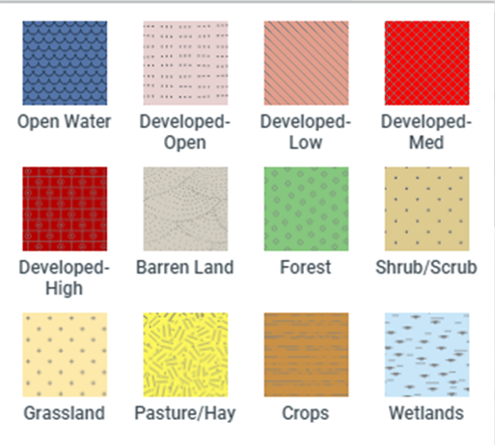
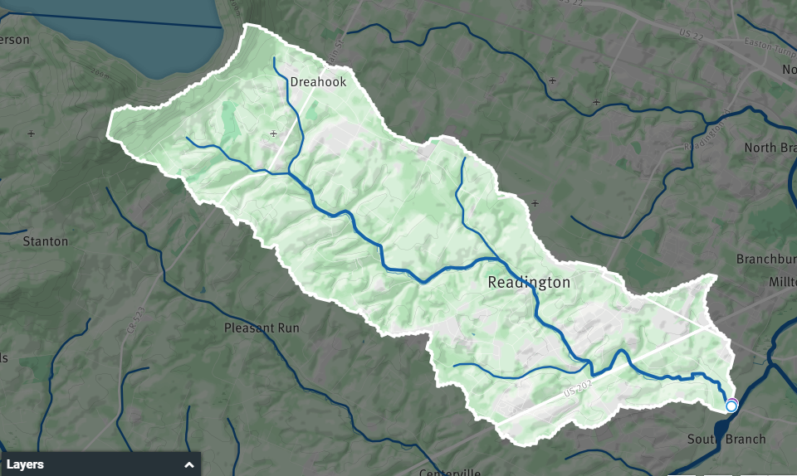
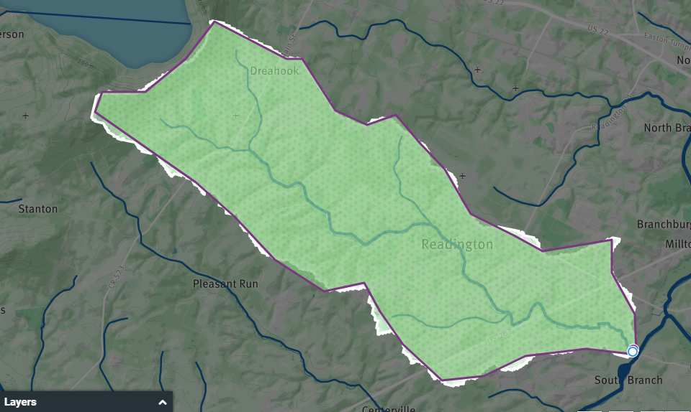
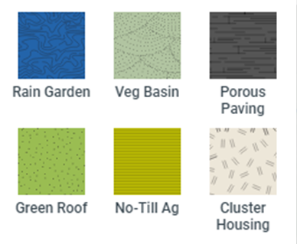
WikiWatershed.org
Model Tool
Notes:
You can select your area of interest. It could be your home or your town. In this case I highlighted the Holland Brook Watershed in Readington and Branchburg Townships.
-You can model the impact of different conservation practices like rain gardens or porous paving or green roofs or you can change land cover.
-Today, I am going to forest the entire watershed to make an exaggerated case for the importance of trees.
-You can also choose the size of the rain event. In this case 5 cm is about the equivalent of 2 inches

Slide 13
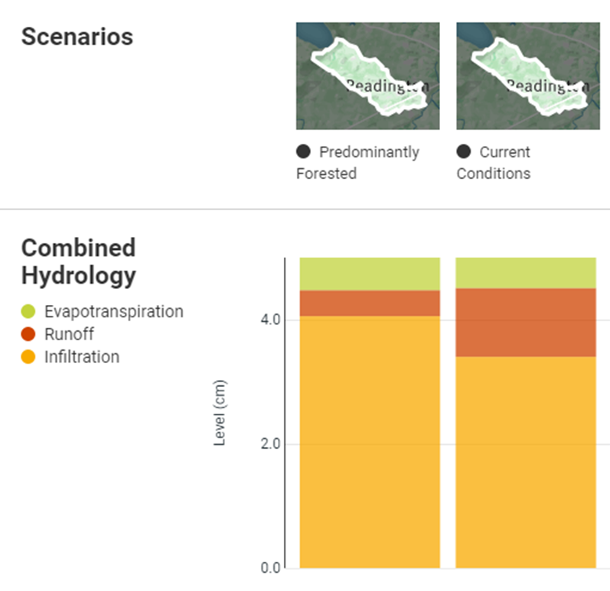
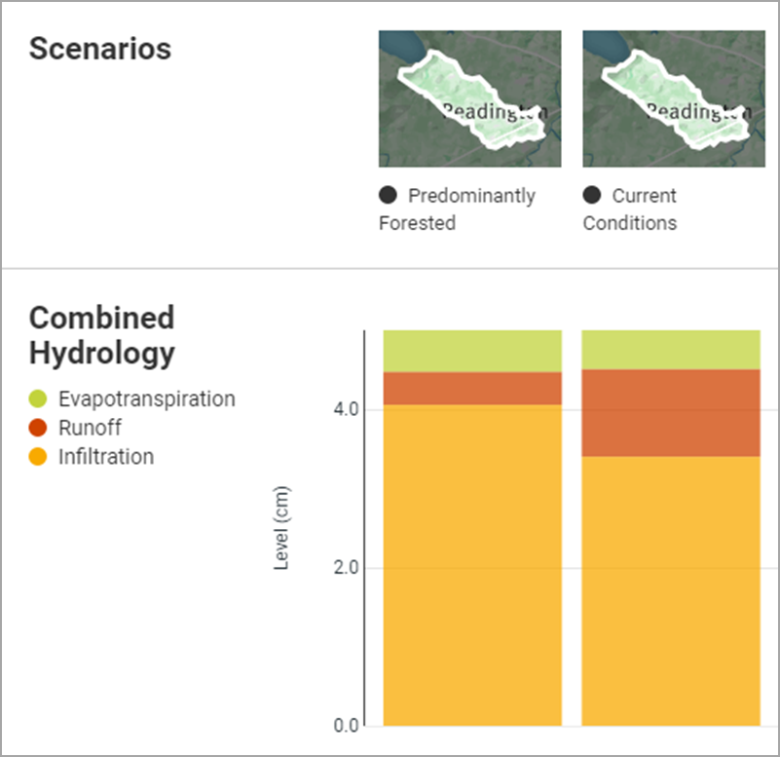
WikiWatershed Model Tool
Precipitation 5.00 cm
Infiltration increased by
12%
Total Phosphorus decreased by 90%
Total Nitrogen decreased by 90%
Notes:
-The bar graph illustrates where the 5 cm of rain ends up based on current condiitions as well as our forested scenario. The orange illustrates infiltration into the ground which is desirable and the red illustrates how much runoff will occur and potentially lead to flooding. The green represents how much water will evapotranspirate into the air
Predominantly forested conditions
-0.5 cm will be evapotranspirated
-0.4 will be runoff
-4.0 cm will be Infiltrated
Current Conditions
-0.5 cm will be evapotranspirated
-1.1 cm will be runoff
-3.4 will be infiltrated
Total Nitrogen
-Current conditions has a loading rate of 0.379 kg/ha
-Predominantly forested has a loading rate of 0.042 kg/ha
-Difference is 0.337
Total Phosphorus
-Current conditions has a loading rate of 0.05 kg/ha
-Predominantly forested has a loading rate of 0.006 kg/ha
Difference is 0.044

Slide 14

Stabilizes
Bank
Slows Runoff
&
Reduces Flooding
Filters Pollution
& Sediment
Provides
Shade
Provides
food for
aquatic
life
Creates
Habitat
Riparian Buffers
Provide
Ecosystem Services
Notes:
The area of Trees and other vegetation along streams are referred to riparian buffers. Riparian buffers provide important ecosystem services
-Trees along streams provide habitat for the aquatic life by dropping twigs and branches into the stream
-Trees also drop leaves into the stream which provide the base of the food chain for the benthic macroinvertebrates that shred them.
-Trees also shade the stream which keeps water temperature cooler and ensuring that there is dissolved oxygen in the water for the aquatic life to breathe
-Trees slow down stormwater and allows it to infiltrate the ground and recharge ground water. This process will also reduce flooding.
-Less water reaching the stream, also reduces soil erosion which stabilizes the stream bank
-Finally, trees can capture sediment and filter out pollution like nitrates and phosphates!

Slide 15
Buffer Regulations
300 feet on both sides
  Category 1 Streams, including Trout Production streams and their tributaries
150 feet on both sides of
  An upstream tributary to a trout production water not in the HUC-14 watershed;
  A trout maintenance water body and all upstream tributaries within one mile;
  Any segment of water flowing through an area containing documented habitat for a threatened or endangered species of plant or animal;
  Any segment of water flowing through an area containing acid producing soils.
50 feet along both sides of all other waters.
Notes:
-North Jersey Resource Conservation & development council
-Raritan Headwaters has already organized a tree planting in PG and has two additional plantings planned in Readington (Bob Becker) and Raritan Twp (Amy Greene)
The Roots for Rivers program will provide funding to buy trees and tree tubes to protects the trees.

Slide 16
Implementing a Volunteer Tree Planting
Choosing a location
Calculating # of trees and Shrubs
Species and sources
Other equipment needs
Recruiting volunteers/PR
Longterm Follow up
Funding and partners
Demo of RHA’s Buffer Gap ID Tool
Notes:
-North Jersey Resource Conservation & development council
-Raritan Headwaters has already organized a tree planting in PG and has two additional plantings planned in Readington (Bob Becker) and Raritan Twp (Amy Greene)
The Roots for Rivers program will provide funding to buy trees and tree tubes to protects the trees.

Slide 17
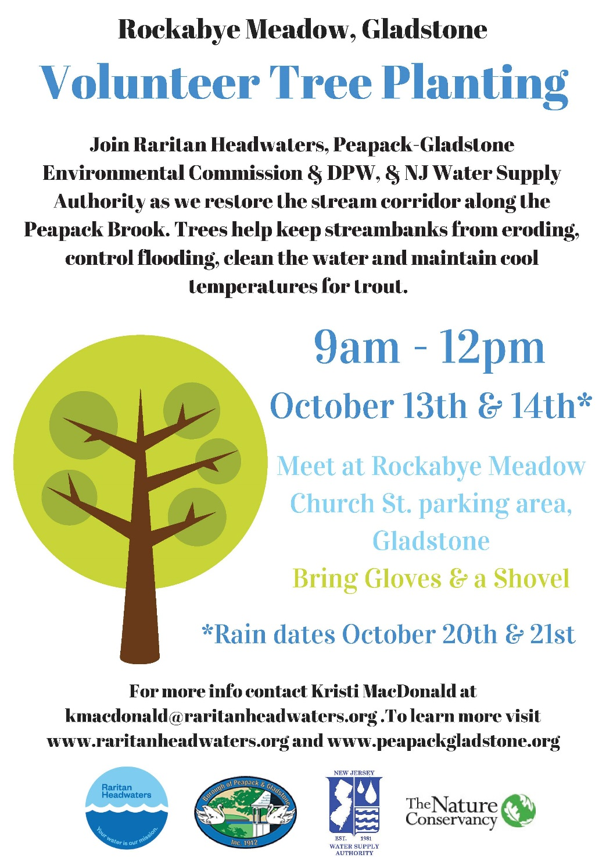
Notes:
-North Jersey Resource Conservation & development council
-Raritan Headwaters has already organized a tree planting in PG and has two additional plantings planned in Readington (Bob Becker) and Raritan Twp (Amy Greene)
The Roots for Rivers program will provide funding to buy trees and tree tubes to protects the trees.

Slide 18
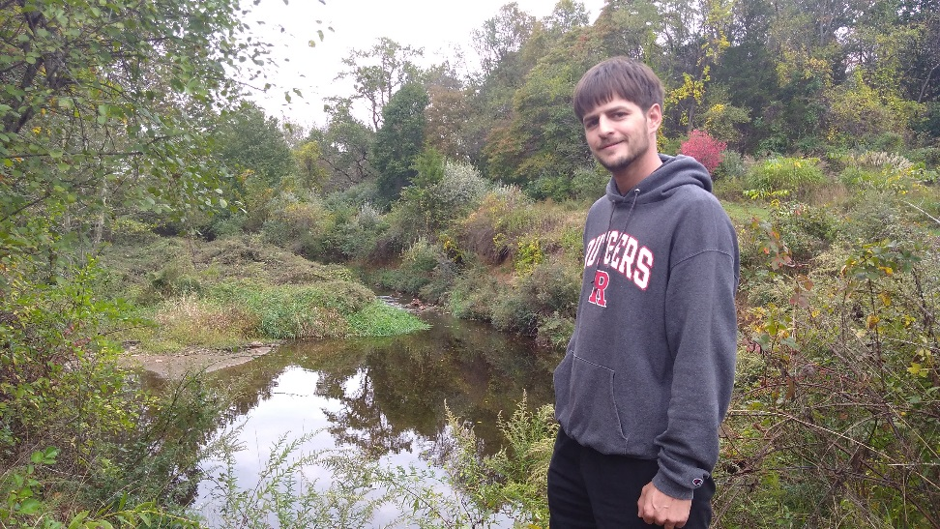
Choosing a Location
RHA Buffer Gap ID Tool
Your own observations
Public Land
Problem areas:
  Streambank erosion
  Flooding problems
Notes:
-North Jersey Resource Conservation & development council
-Raritan Headwaters has already organized a tree planting in PG and has two additional plantings planned in Readington (Bob Becker) and Raritan Twp (Amy Greene)
The Roots for Rivers program will provide funding to buy trees and tree tubes to protects the trees.

Slide 19
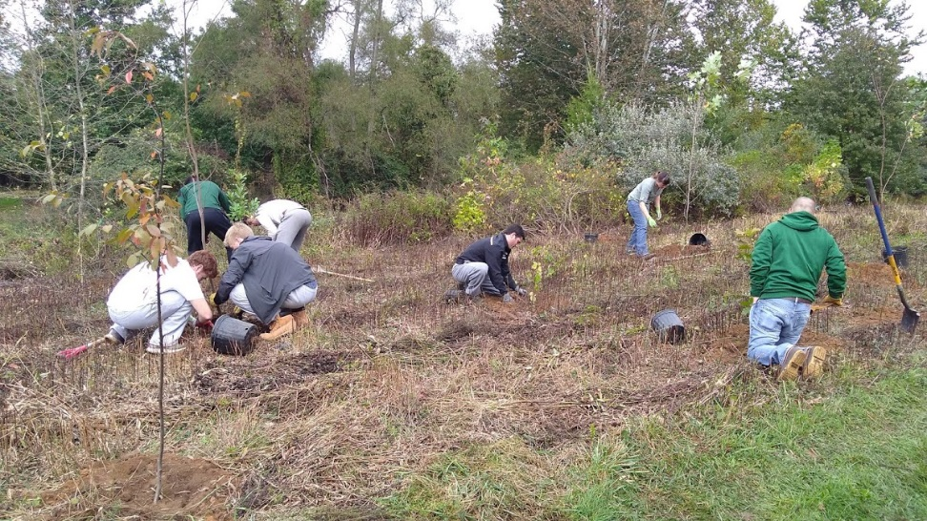
How many trees and shrubs to plant?
Approximately 100 trees and shrubs per acre
Calculate approximate length of stream then width of 30 ft on each side
Spacing for shrubs 5-8 ft. and large trees 8-12 ft.
Notes:
-North Jersey Resource Conservation & development council
-Raritan Headwaters has already organized a tree planting in PG and has two additional plantings planned in Readington (Bob Becker) and Raritan Twp (Amy Greene)
The Roots for Rivers program will provide funding to buy trees and tree tubes to protects the trees.

Slide 20
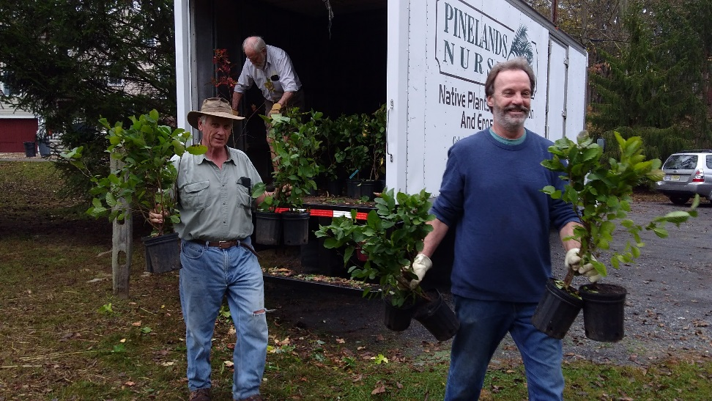
Tree species
Site prep may be needed
Select a variety of native trees and shrubs; some species that are associated with riparian zone include willows, silver maple, boxelder, river birch, pin oak, alders and silky dogwood
Some more upland species may be planted as well
Large trees in containers, bare root seedlings, and live stakes
Notes:
-North Jersey Resource Conservation & development council
-Raritan Headwaters has already organized a tree planting in PG and has two additional plantings planned in Readington (Bob Becker) and Raritan Twp (Amy Greene)
The Roots for Rivers program will provide funding to buy trees and tree tubes to protects the trees.

Slide 21
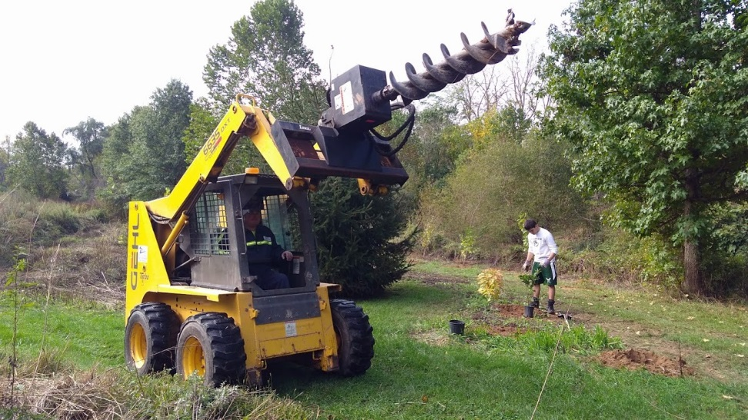
Other equipment
Rent or borrow an auger for planting larger trees
Shovels, gloves, clippers etc.
Tree protection tubes and stakes or deer fencing
Notes:
-North Jersey Resource Conservation & development council
-Raritan Headwaters has already organized a tree planting in PG and has two additional plantings planned in Readington (Bob Becker) and Raritan Twp (Amy Greene)
The Roots for Rivers program will provide funding to buy trees and tree tubes to protects the trees.

Slide 22
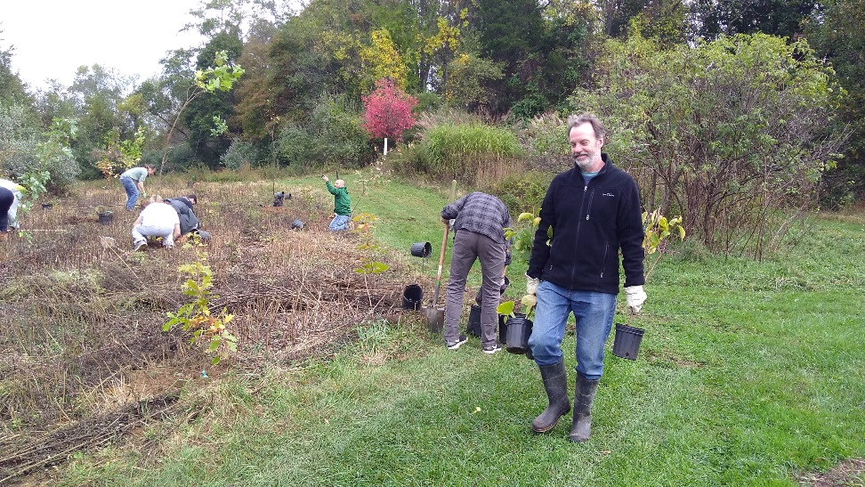
Recruiting Volunteers & PR
Identify groups to partner with including the Environmental Commission, DPW, Green Team, Scouts, schools
Keep in mind parking and other access issues to the site ahead of time and give clear directions
Prepare flyers and press releases, social media campaign
Notes:
-North Jersey Resource Conservation & development council
-Raritan Headwaters has already organized a tree planting in PG and has two additional plantings planned in Readington (Bob Becker) and Raritan Twp (Amy Greene)
The Roots for Rivers program will provide funding to buy trees and tree tubes to protects the trees.

Slide 23
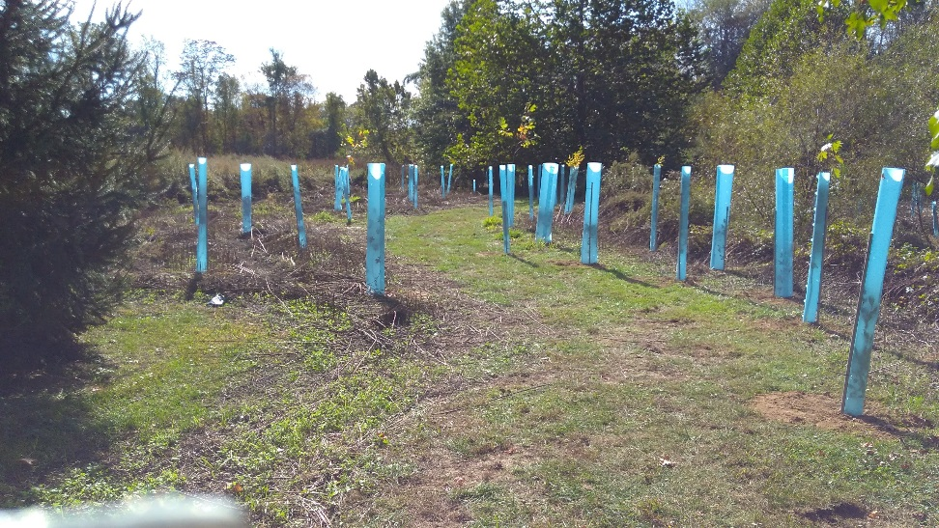
Follow up and longterm care
Continue to periodically visit the site to check if tree protection is intact and make repairs
Annually replace lost trees (we see about 25% mortality)
Remove invasive plants around tree plantings
Notes:
-North Jersey Resource Conservation & development council
-Raritan Headwaters has already organized a tree planting in PG and has two additional plantings planned in Readington (Bob Becker) and Raritan Twp (Amy Greene)
The Roots for Rivers program will provide funding to buy trees and tree tubes to protects the trees.

Slide 24
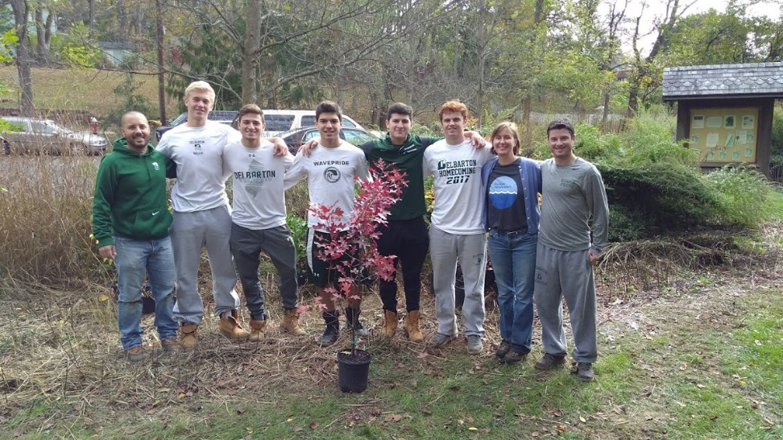
Funding & Partners
Partners
  Decide who is the project lead
  Enlist one or two partners, preferably local
Grants
  TNC Roots for Rivers
  NJ American Water
  Other
Notes:
-North Jersey Resource Conservation & development council
-Raritan Headwaters has already organized a tree planting in PG and has two additional plantings planned in Readington (Bob Becker) and Raritan Twp (Amy Greene)
The Roots for Rivers program will provide funding to buy trees and tree tubes to protects the trees.

Slide 25
RHA’s Stream Buffer Gap ID Tool
Notes:
-North Jersey Resource Conservation & development council
-Raritan Headwaters has already organized a tree planting in PG and has two additional plantings planned in Readington (Bob Becker) and Raritan Twp (Amy Greene)
The Roots for Rivers program will provide funding to buy trees and tree tubes to protects the trees.

Slide 26

Next Steps
Raritan Headwaters can partner with your municipality to organize a tree planting!
As follow up for today’s seminar, you will receive via email:
RHA’s Buffer Gap Id Tool – map of your town
NRCS Riparian Buffer Guidelines
Sample tree order form
Sources of native trees and shrubs
Sources for tree protection
Sample flyer
Grants: TNC’s Roots for Rivers, NJ American Water
Notes:
-North Jersey Resource Conservation & development council
-Raritan Headwaters has already organized a tree planting in PG and has two additional plantings planned in Readington (Bob Becker) and Raritan Twp (Amy Greene)
The Roots for Rivers program will provide funding to buy trees and tree tubes to protects the trees.

Slide 27
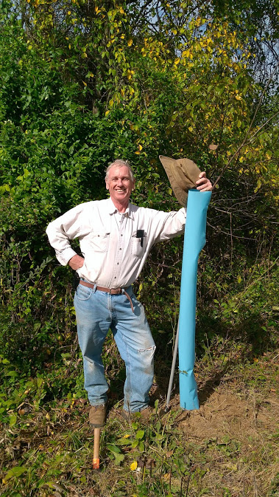
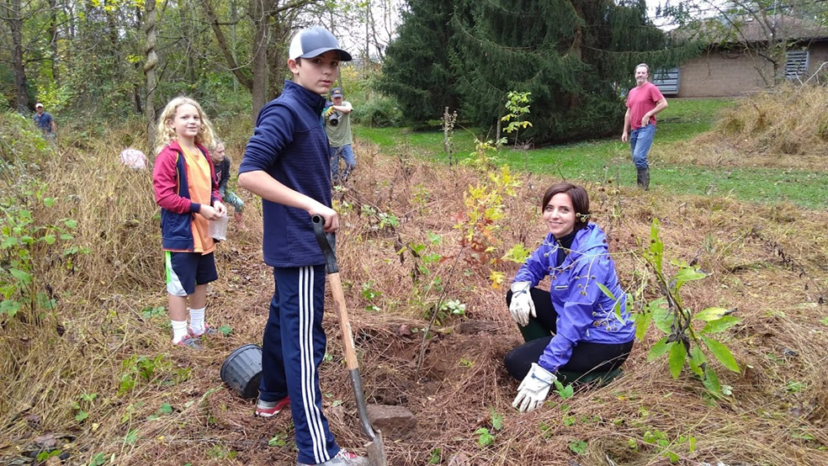
LET’S PLANT TREES!!!

