Slide 1
NJ-GeoWeb Interactive Basics Workshop
May 16, 2018
NJDEP – Bureau of GIS
Robert Muska
Email:GISnet@dep.nj.gov
Phone: 609-777-0672

Slide 2
What is a Geographic Information System (GIS)?
“A computer-based system used to
capture, store, edit, display,
analyze, and plot geographically
referenced data at any scale”

Slide 3
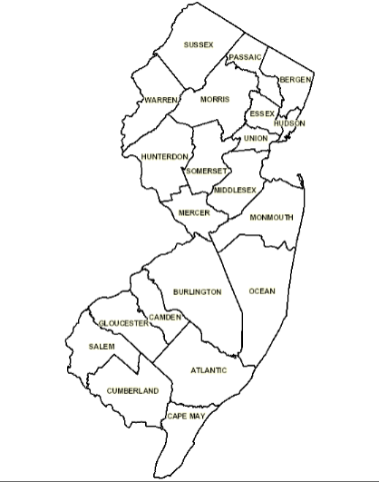
At its most basic: A digital interactive map
Where features located on a map are tied to a spatial reference system (e.g. Longitude/ Latitude)

Slide 4
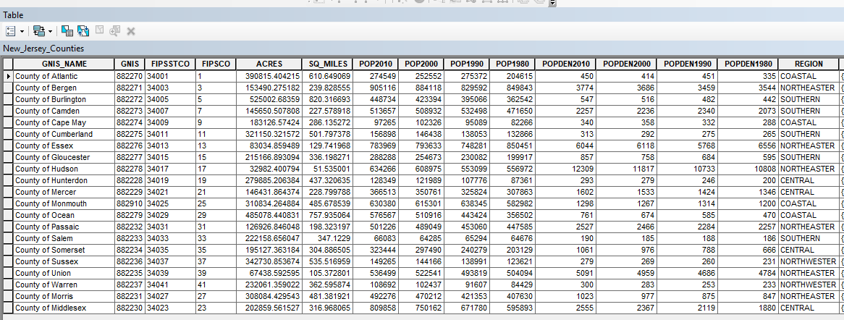
GIS includes a database
The database stores additional descriptive information about each feature in a table

Slide 5
GIS data can be represented as:
Points (contaminated sites, child care centers)
Lines (streams, roads)
Polygons (municipal boundaries, wetlands)
Raster data (grid cells and imagery)

Slide 6
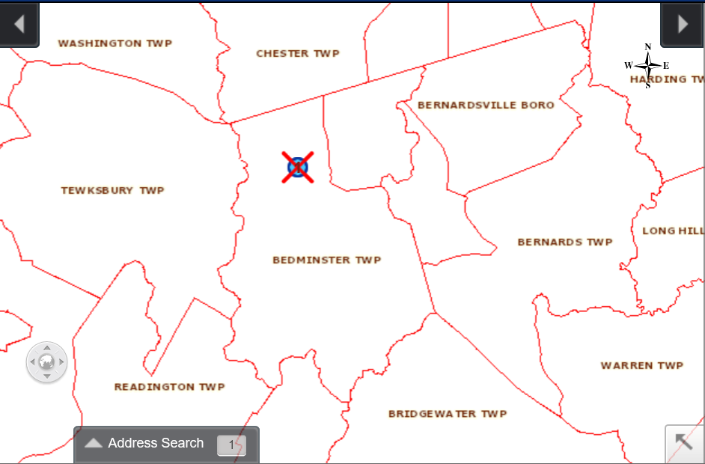
Polygon Layer
Municipal Boundaries

Slide 7
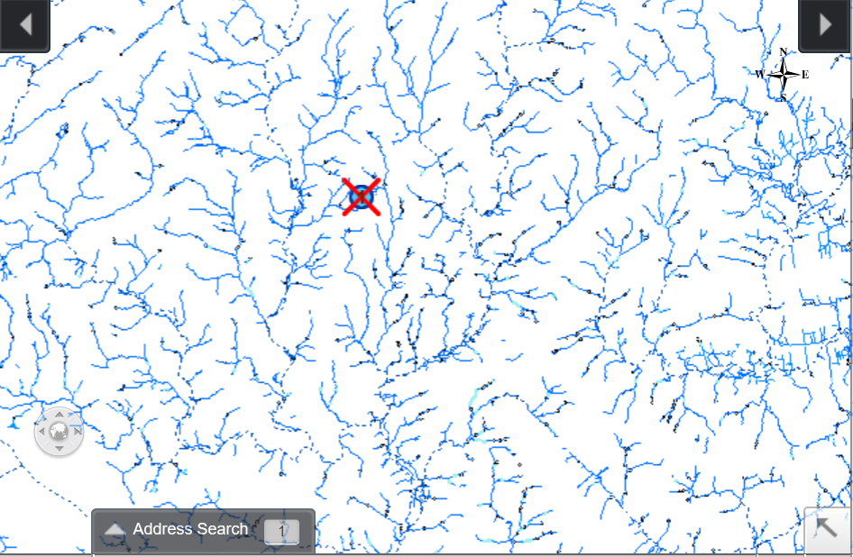
Line Layer
Streams

Slide 8
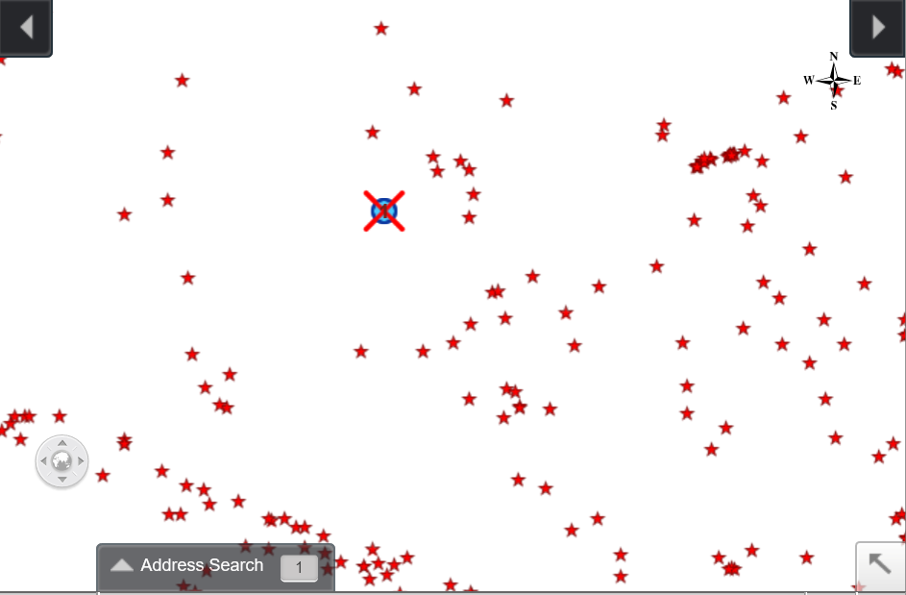
Point Layer
Contaminated Sites

Slide 9
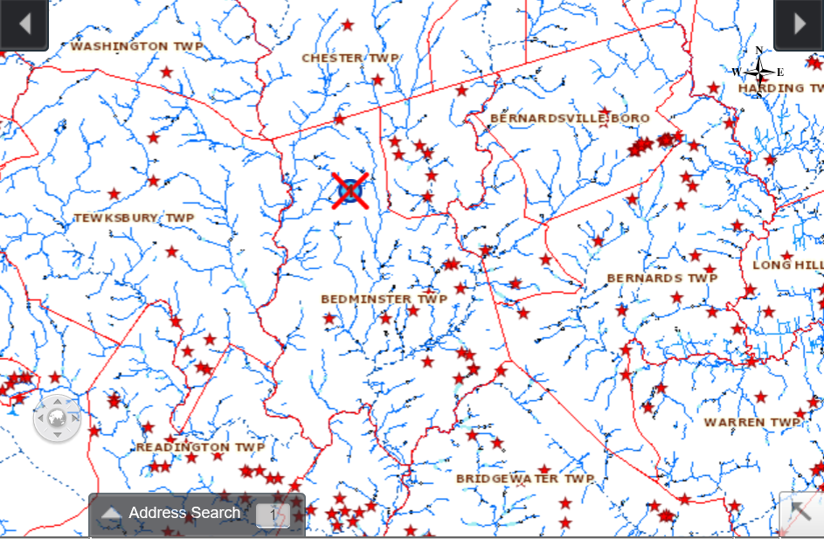
The layers can be combined into one map.
Municipal boundaries + Streams + Contaminated sites

Slide 10
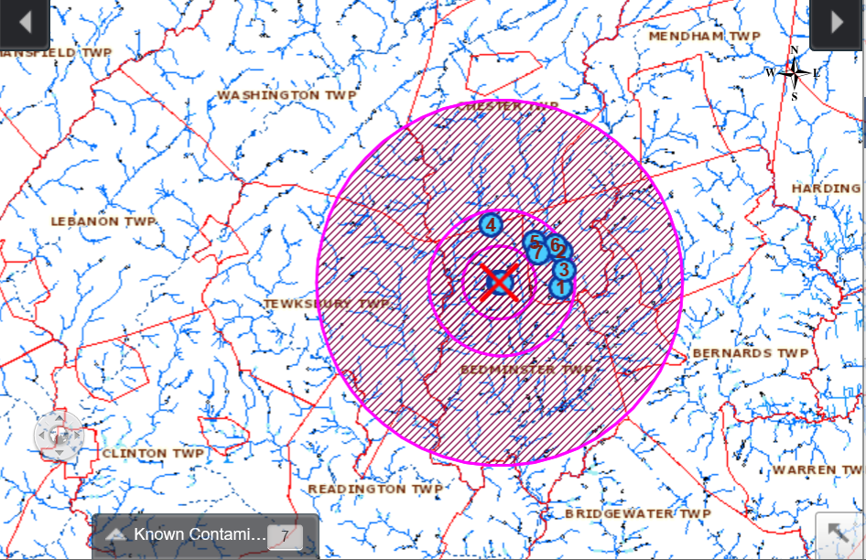
GIS provides powerful geoprocessing tools for analysis
Example: Using buffering tool to show contaminated sites within 1,2 and 5 miles radius

Slide 11
Data layers that are particularly useful for environmental groups
Parcels (Lot and Block)
Wetlands
Critical environmental and Historical Sites
Land use
Impervious surface
Open space
Known contaminated sites
NJPDES Discharge Points- Surface Water
Water Source Areas
Well head protection areas
Highlands planning area
Sewer Services areas
Streams
Category one waters
Aquifers
Watersheds
Topographic images
Imagery (natural)
Imagery (infrared)

Slide 12
NJ-GeoWeb
Online GIS application
Comprehensive collection of environmental data available to public
Data collected and processed by the NJDEP
and other state agencies
Includes detailed metadata which describes the data
Easy to use analysis tools
Free application

Slide 13
Useful Resources
NJDEP Bureau of GIS Help Desk:
http://www.nj.gov/dep/gis/contactbgis.html
Download site for NJDEP GIS data:
http://www.nj.gov/dep/gis/stateshp.html
Download site for NJ Department of GIS :
http://njogis-newjersey.opendata.arcgis.com/
FEMA online site for viewing online flood hazard map:
https://msc.fema.gov/portal/search
Robert Muska, Email: GISnet@dep.nj.gov
Phone: 609-777-0672

