Slide 1
Watershed Tools for Local Leaders Local Solutions to Local Problems
Addressing Stormwater in Your Community

Slide 2
Watershed Tools for Local Leaders Addressing Stormwater in Your Community
Is stormwater a problem?
Is the problem getting worse?
Stormwater isn’t just water
How does your community deal with stormwater?
Can stormwater be addressed successfully?
Do you need more information?
Do you need money?

Slide 3
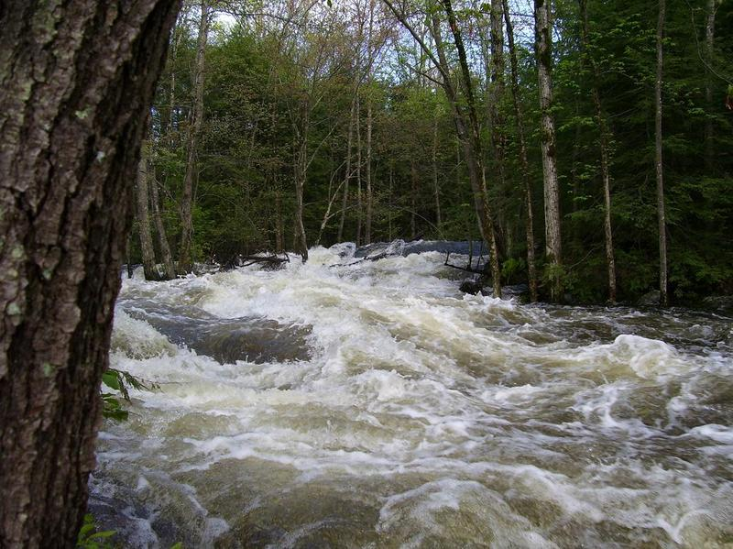
Is Stormwater a Problem?
South Branch, Raritan River, Hurricane Irene, October 2011
Notes:
>10,000 cfs/quantity is an issue

Slide 4
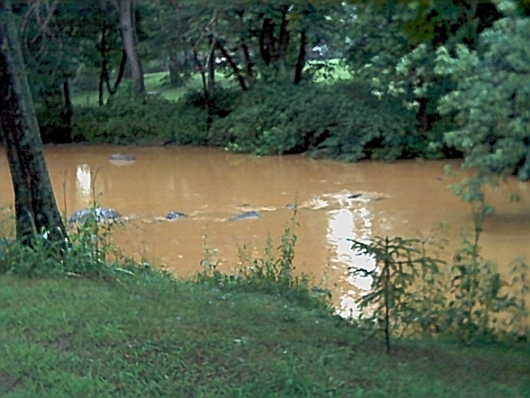
Is Stormwater a Problem?
South Branch, Raritan River, May 2019
Notes:
276 cfs/quality is an issue

Slide 5
Is the problem getting worse?

Slide 6
Is the Problem Getting Worse? QUIZ!
The average amount of additional annual rainfall now received in the Raritan Basin is enough to fill:
a. Spruce Run Reservoir (11 billion gallons)
b. Wanaque reservoir (30 billion gallons)
c. Round Valley Reservoir (55 billion gallons)
d. All of the above
Notes:
65 billion gallons in RHA; 99 billion gallons basin wide

Slide 7
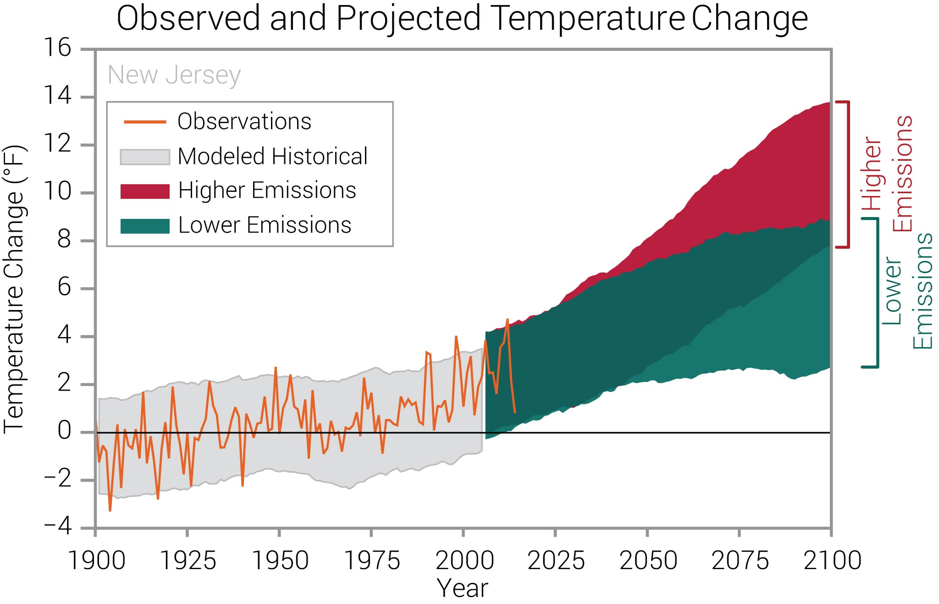
Is the Problem Getting Worse?

Slide 8
Watershed Tools for Local Leaders Addressing Stormwater in Your Community
1. How are we paying for stormwater now?
2. How do we pay for new stormwater projects?
3. What is a stormwater utility?
What are its benefits?
Do we need one?
How do we fund it?

Slide 9
Watershed Tools for Local Leaders Addressing Stormwater in Your Community
1. Advantages of a Stormwater Utility
Local solution to a local problem
Flexible, Equitable, and Dedicated
Cost-effective way to address stormwater
2. Do we need one?
Feasibility study
3. What does it cost and who pays?

Slide 10
Watershed Tools for Local Leaders Addressing Stormwater in Your Community
Clean Stormwater and Flood Reduction Act:
njleg.state.nj.us/2018/Bills/PL19/42_.PDF
NJ Department of Environmental Protection:
nj.gov/dep/stormwater/
nj.gov/dep/dwq/stormwaterutility.html

Slide 11
Watershed Tools for Local Leaders Addressing Stormwater in Your Community
Where Can I Get More Information?
New Jersey Stormwater Utility Resource Center
stormwaterutilities.njfuture.org
Flood Defense New Jersey
njlcvef.org/flood-defense/resources
Rutgers
njaes.rutgers.edu/environment/
An Internet Guide to Financing Stormwater Management
cues.rutgers.edu/meadowlands-district-stormwater/pdfs/Doc18_Internet%20guide%20to%20financing%20stormwater%20management.pdf
Developing a Stormwater Management Utility
cues.rutgers.edu/meadowlands-district-stormwater/pdfs/Doc25_Cyre1987_Developing_a_Utility.pdf

Slide 12
Thank you for attending today’s Watershed Tools for Local Leaders Workshop For upcoming and archived workshops visit
https://www.raritanheadwaters.org/municipal-tools/
For more information contact Kristi MacDonald at kmacdonald@raritanheadwaters.org

